Slide 1
Sales Insights-Data Analysis Dashboard for AtliQ Hardware

Slide 2
Business objective
AtliQ is a company that owns multiple hotel chains across various cities of India
Task was to develop a KPI Dashboard for the company, using the given data which can help track its revenue sources and other relevant KPIs across various aspects.
It’ll help the company to take strategic business decisions based on the insights from the dashboard.

Slide 3
Problem statement / Project scope
AtliQ hardware is a company which delivers computer hardware & peripheral Manufacturers to his clients, which has several branches throughout India. The sales director of the company is facing a lot of issues in terms of understanding how the business is performing and what are all the problem company is facing currently as the sales are not as expected and declining gradually. And whenever he calls the regional managers to get the current status of the sales and market, as a human behaviour, these people Humans are not comfortable in consuming numbers from excel files, which is obvious reason for the frustration

Slide 4
Solution approach
To address the problem statement, the following approach was used:
* Data Import and Initial Analysis:
The sales data was provided in a SQL dump file, which was imported into a SQL database. Initial insights were drawn from the data using SQL queries and analysis techniques to gain a preliminary understanding of the sales trend.
* Connecting SQL Database to Power BI:
The SQL database was connected to Power BI, establishing a live connection or importing the necessary data tables into Power BI.
* Data Modeling and Relationship Creation:
Data modeling was performed within Power BI to create relationships between the relevant tables in the SQL database. This step ensured that the data could be properly analyzed and visualized.

Slide 5
* Dashboard Creation - Key Insights:
The first type of dashboard, "Key Insights," was created to provide an overview of the sales trend. This dashboard focused on presenting high-level metrics, such as total sales, top-selling products, sales by region, and sales by time period. Visualizations like charts, graphs, and KPIs were used to convey the key insights effectively.
* Dashboard Creation - Profit Analysis:
The second type of dashboard, "Profit Analysis," aimed to provide in-depth insights into the profitability of AtliQ hardware goods. This dashboard included visualizations and calculations related to profit margins, cost analysis, and product profitability. It allowed users to identify profitable products, assess cost effectiveness, and optimize pricing strategies.
* Dashboard Creation - Performance Insights:
The third type of dashboard, "Performance Insights," focused on analyzing the performance of AtliQ hardware goods. This dashboard provided visualizations and metrics related to sales performance, sales growth, customer segmentation, and market share. It enabled users to track performance trends, identify growth opportunities, and make data-driven decisions.
Each dashboard was designed to be interactive, allowing users to filter and drill down into specific dimensions or time periods of interest.

Slide 6
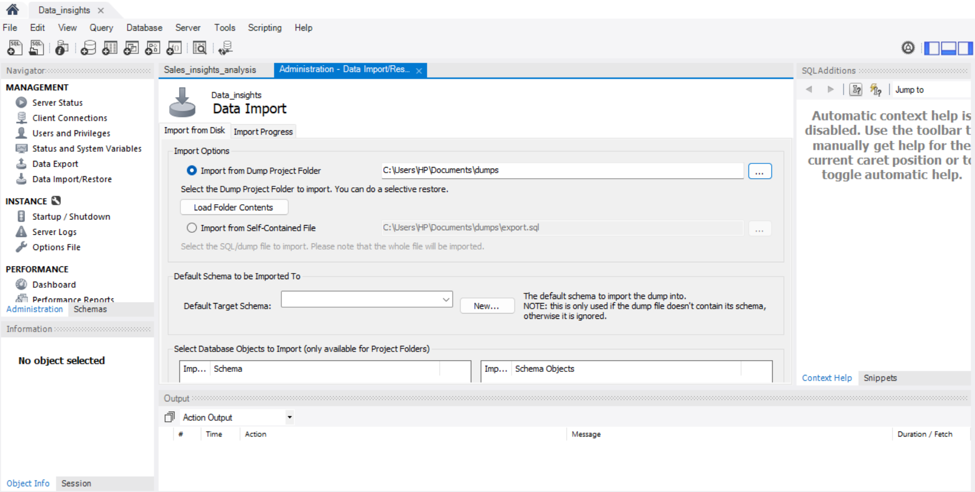
Data Analysis using MySQL

Slide 7
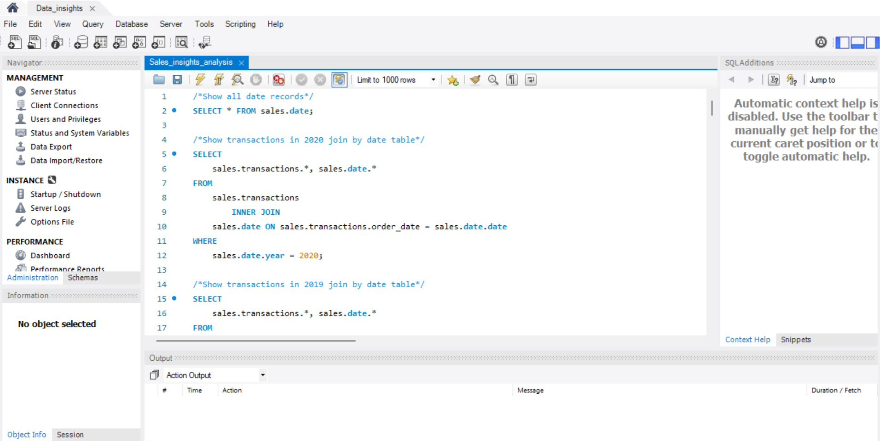
Queries:

Slide 8
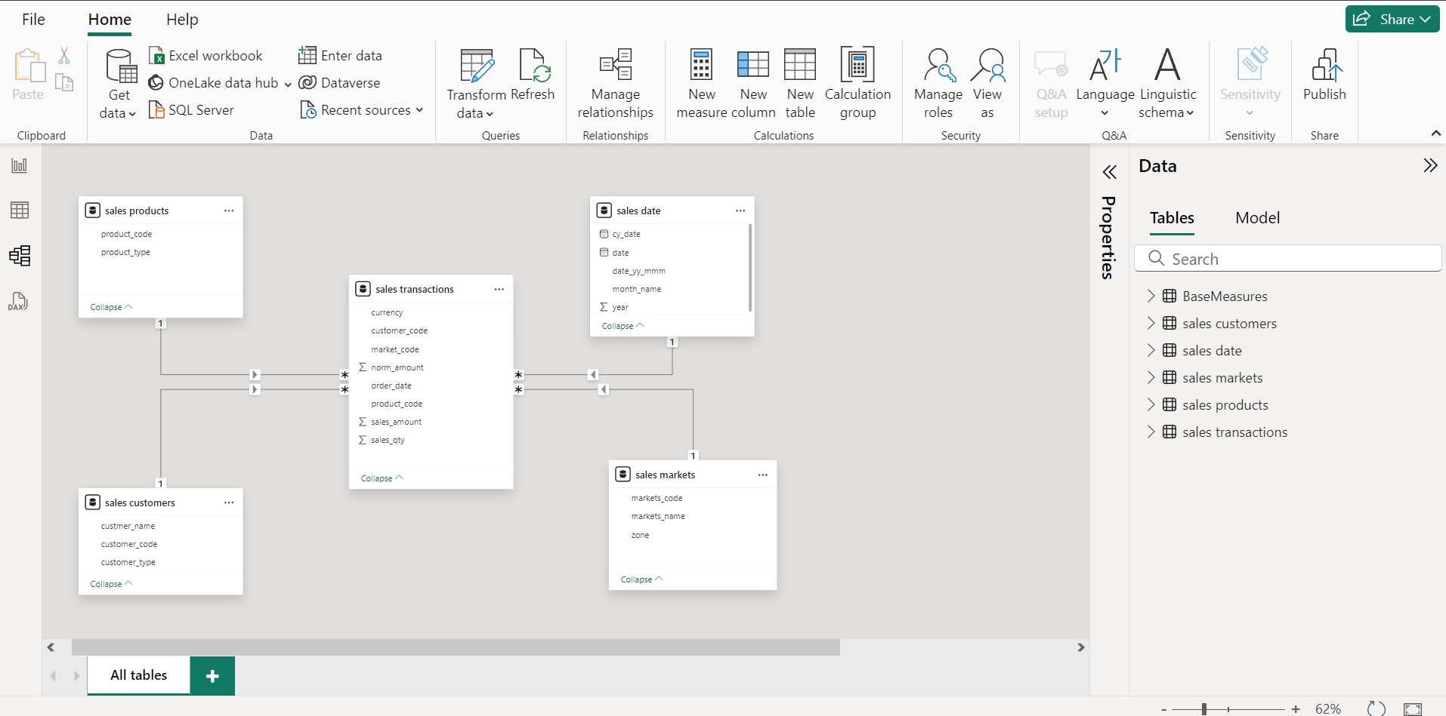
Data modelling in Power Pivot

Slide 9
Various Queries Used
SELECT * FROM sales.marke
SELECT * FROM sales.transactions;
1.To find of all customers records
SELECT * FROM sales.customers;
2.To find total number of customers
SELECT count(*) From sales.customers;
3.To find transactions for Chennai market (market code for chennai is Mark001
SELECT * FROM sales.transactions where market_code='Mark001';
4.To find distrinct product codes that were sold in chennai
SELECT distinct product_code FROM sales.transactions where market_code='Mark001';
5.To find transactions for Chennai market (market code for chennai is Mark002
SELECT * FROM sales.transactions where market_code='Mark002';

Slide 10
Queries:
6.To find distrinct product codes that were sold in Mumbai
SELECT distinct product_code FROM sales.transactions where market_code='Mark002';
7.To find transactions where currency is US dollars
SELECT * from sales.transactions where currency="USD";
8.To find transactions in 2020 join by date table
SELECT sales.transactions.*, sales.date.* FROM sales.transactions INNER JOIN sales.date ON sales.transactions.order_date=sales.date.date where sales.date.year=2020;
9.To find total revenue in year 2020,
SELECT SUM(sales.transactions.sales_amount) FROM sales.transactions INNER JOIN sales.date ON sales.transactions.order_date=sales.date.date where sales.date.year=2020 and sales.transactions.currency="INR\r" or sales.transactions.currency="USD\r";
10.To find total revenue in year 2019,
SELECT SUM(sales.transactions.sales_amount) FROM sales.transactions INNER JOIN sales.date ON sales.transactions.order_date=sales.date.date where sales.date.year=2019 and sales.transactions.currency="INR\r" or sales.transactions.currency="USD\r";
11.To find total revenue in year 2020, January Month,
SELECT SUM(sales.transactions.sales_amount) FROM sales.transactions INNER JOIN sales.date ON sales.transactions.order_date=sales.date.date where sales.date.year=2020 and sales.date.month_name="January" and (sales.transactions.currency="INR\r" or sales.transactions.currency="USD\r");

Slide 11
Data Cleaning
`SELECT count(*) from sales.transactions where sales.transactions.currency="INR\r";`
150000 - can't removed as it is large amount
`SELECT count(*) from sales.transactions where sales.transactions.currency="INR";`
279 - we can remove it as it is small record and can be considered as bad data
`SELECT count(*) from sales.transactions where sales.transactions.currency="USD\r";`
`SELECT count(*) from sales.transactions where sales.transactions.currency="USD";`
`SELECT * from sales.transactions where sales.transactions.currency='USD\r' or sales.transactions.currency='USD';`

Slide 12
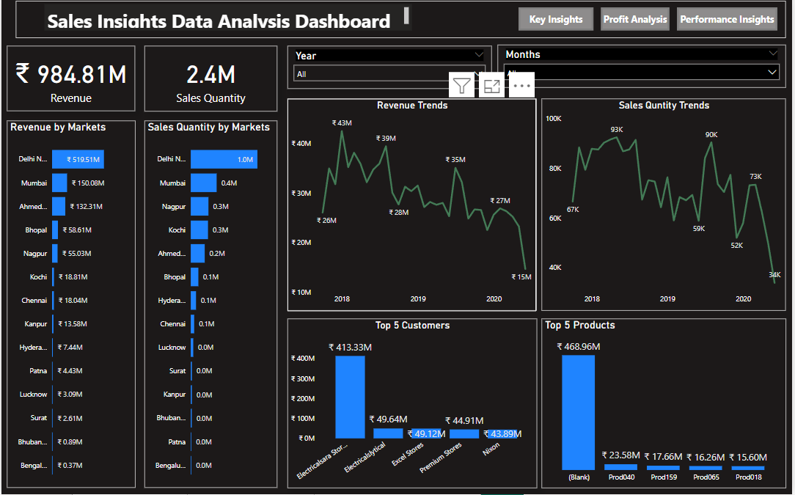
Dashboard

Slide 13
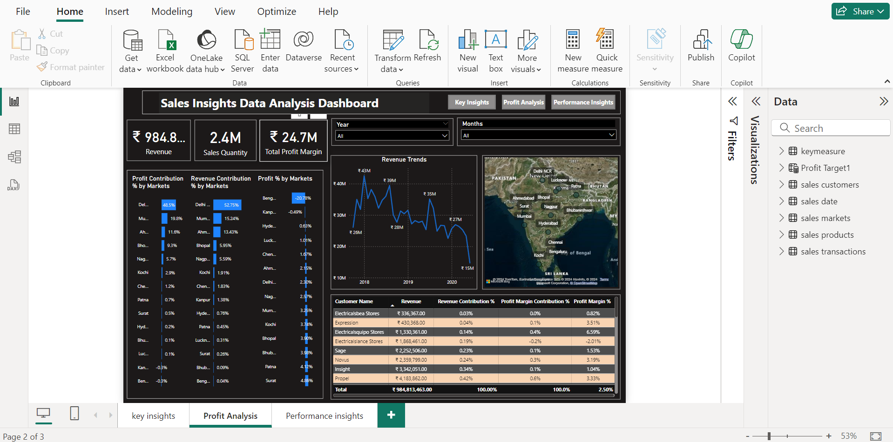
Profit Analysis

Slide 14
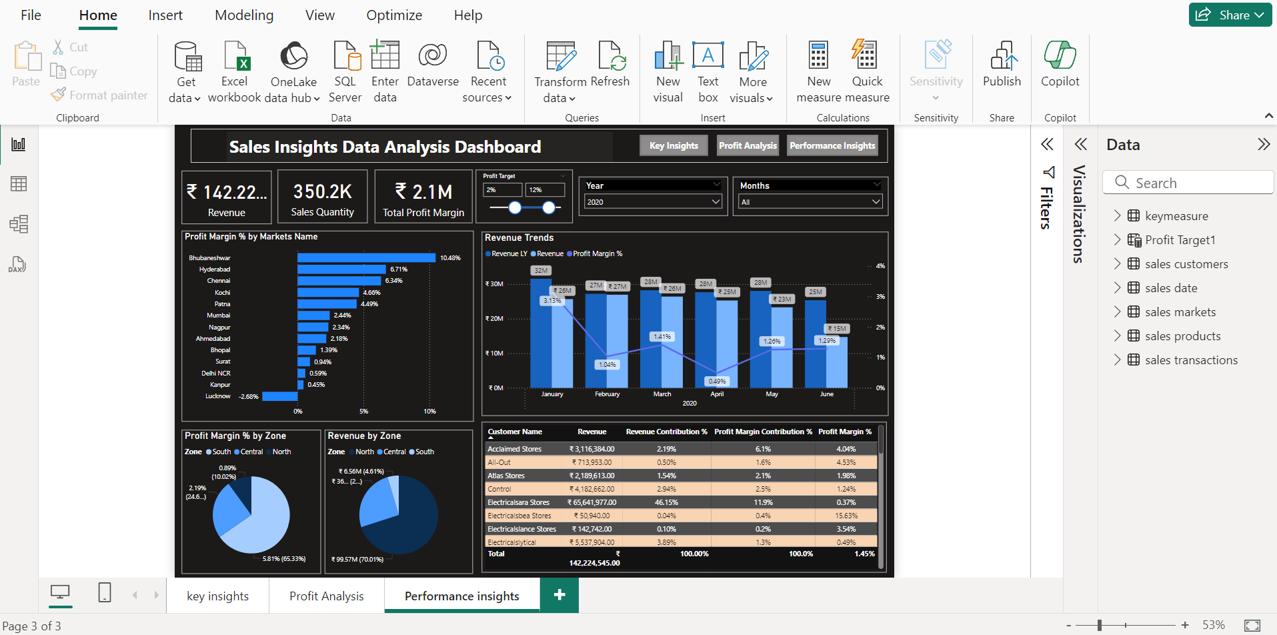
Performance Analysis

Slide 15
Insights
In this dashboard, we can see company has generated total revenue in 4 years ₹ 985M, total profit margin ₹24.7M, Profit margin% 2.5%, Sales Qty ₹2M. in 2020 company has generated total revenue of ₹ 142M by selling a total of 350K and earned a profit of ₹ 2.1M.
In 4 years Delhi NCR is our largest market in terms of revenue with ₹ 520M and total contribution of 52.8% with total revenue but if you look at the profit margin Delhi NCR is generating only 2.3% profit margin.
If we check the profit margin then here In 2020 Bhubaneshwar comes into the picture which is generating the highest profit margin of 10.48%. Similarly, if we can check the Profit Contribution % by Market then here Mumbai is the largest player with 23.89% of total contribution in total profit.
In 4 years Bengaluru generating the lowest profit margin of -20.8%.if we can check the Profit Contribution % by Market then here also Bengaluru is the Lower with -0.3% of total contribution in total profit.
In our top 5 customers, the Electricalsara Stores is our biggest customer who has generated total ₹ 413 M revenue generated in 4 years.

Slide 16
Insights
In our top 5 products,the Prod318 is our highest product has generated total ₹ 69M revenue generated in 4 years.
In product type Distribution has generated the revenue of ₹494M and ownbrand revenue is ₹494M generated in entire 4 years.
Revenue Trend is showing that in June 2020 revenue has been decreased drastically compared to the revenue last year and the profit margin was the least in April 2020.

Slide 17
Thank you!

